Slide 1

Session Name:
Data Collection
Delivered By:
Vikash Singh

Slide 2

Learning Objectives
By the end of this session, you will be able to:
- Understand primary and secondary data sources
- Learn methods of data collection (questionnaires/schedules)
- Understand sampling techniques and apply them

Slide 3
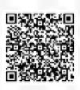

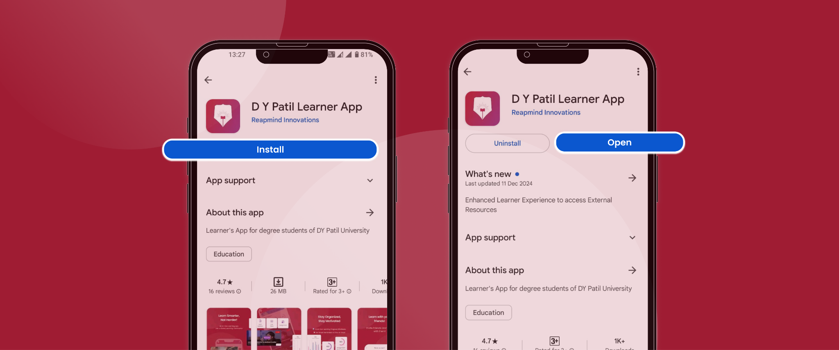
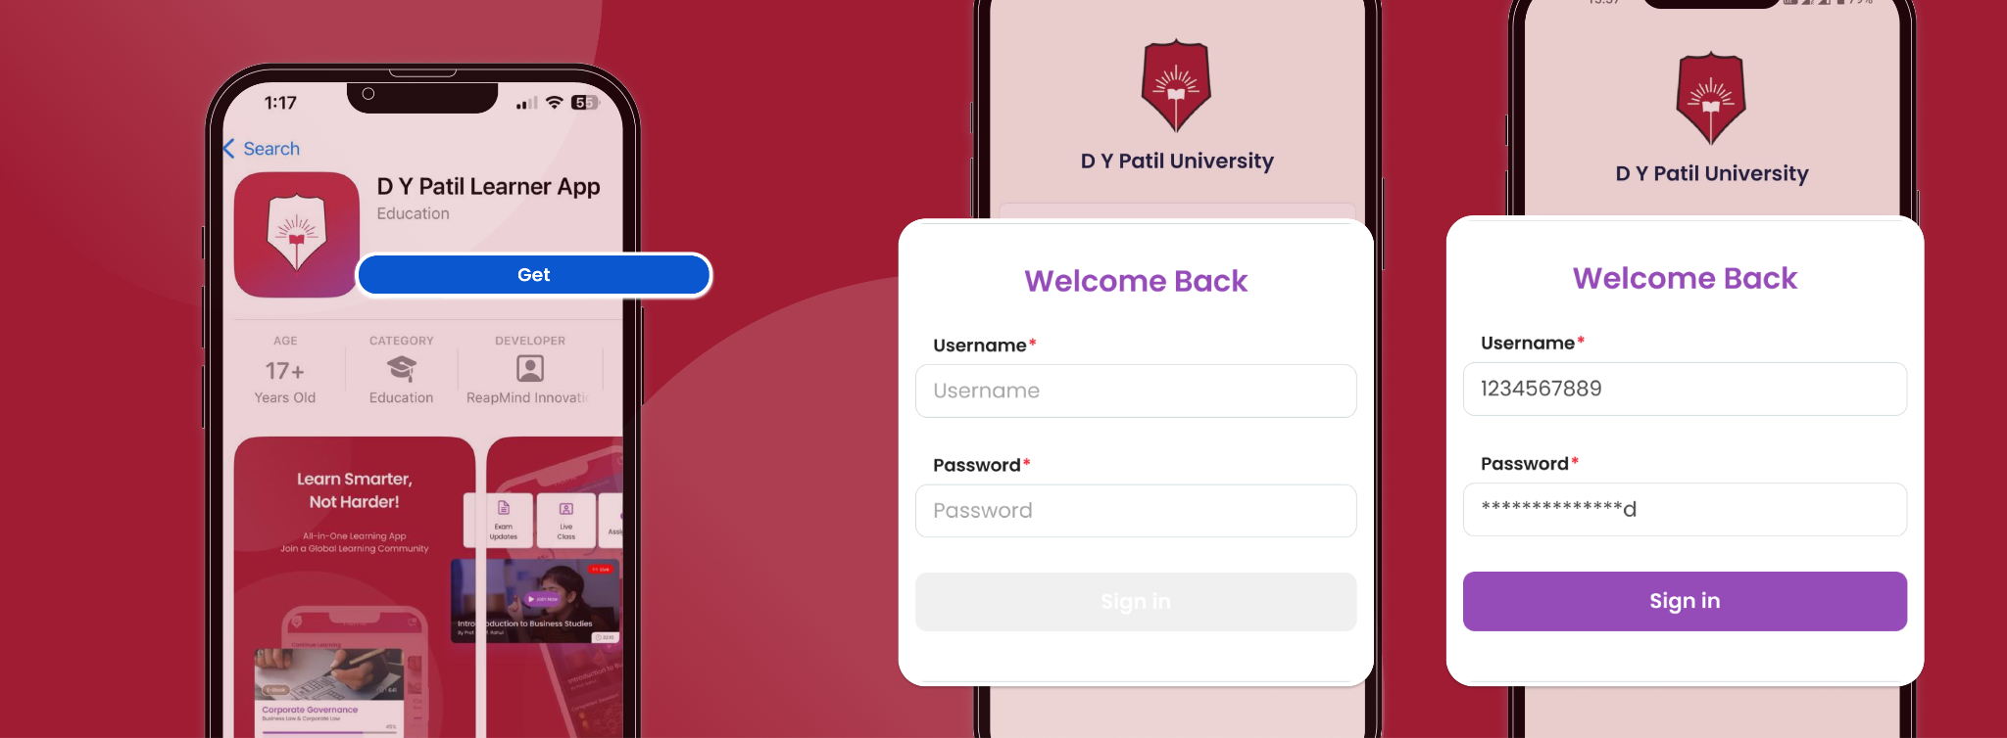
DY Patil Learner App
For Android Users:
Open the Google Play Store on your device and search for "DYP Learner App".
Tap the app from the search results and select Install.
Once installed, tap Open or locate the app on your home screen.
Log in using your LMS credentials.
👉 Download Now: Google Play Store Link
For iOS Users
Open the App Store on your device and search for "DYP Learner App".
Tap the app from the results and select Get to install.
Once installed, tap Open or find the app on your home screen.
Log in using your LMS credentials (registered email ID and LMS password).
👉 Download Now: App Store Link

Slide 4
Data is everywhere!
Every click you make… is DATA.
But where does it come from?
👉 Did you give data today? Where?
(e.g., Google search, WhatsApp poll)

Slide 5
Why Learn Data Collection?
Without data, decisions are just guesses.
Businesses → Netflix suggests your shows
Colleges → Student feedback forms
Governments → Population census

Slide 6
What is Data Collection?
Gathering and measuring information on variables of interest.
Essential for research, business analytics, machine learning

Slide 7
Primary vs Secondary Data
Primary Data:
- First-hand data
- High reliability
- Example: Field survey
Secondary Data:
- Pre-existing data
- Less control over quality
- Example: Government reports

Slide 8
Identify Source Type?
Online survey by you → Primary or Secondary
IMF Report → ?
Amazon reviews → ?
WHO health report → ?

Slide 9
Identify Source Type?
Online survey by you → Primary
IMF Report → Secondary
Amazon reviews → Primary
WHO health report → Secondary

Slide 10
Primary Data Collection Methods
Direct Investigation → Journalist interviews a cricketer 🏏
Indirect Oral → Police asking neighbors about theft 🚨
Questionnaire → College canteen feedback 🍽️
Observation → Mall footfall count 🛍️
Experimentation → Testing a new app feature 📱

Slide 11
Rules for Drafting a Questionnaire
❌ Bad: Don’t you think the new canteen food is terrible?
✅ Good: How would you rate the canteen food? (1–5)

Slide 12
Rules for Drafting a Questionnaire
Define the Objective Clearly.
Use Simple and Clear Language
Keep Questions Short and Focused
Logical Flow of Questions
Use Closed-Ended Questions for Easier Analysis
Include Some Open-Ended Questions Too
Pre-Test the Questionnaire (Pilot Survey)

Slide 13
Sampling

Slide 14
What is Sampling?
Studying a subset to infer about the population
Saves time and cost compared to complete census

Slide 15
Types of Sampling
Random: Equal chance for all. Lucky draw
Systematic: Every kth item. Example: Every 10th student
Stratified: Divide into strata, sample from each. Example: Equal boys & girls
Cluster: Groups sampled entirely. Example: groups based on program type, city, etc.
Convenience: Based on availability. Example: Hostel friends only
Quota: Fixed targets per group. Example: 20 students per dept.

Slide 16
Sample Size Formula
n = (Z² × p(1-p)) / e²
Example: Z = 1.96, p = 0.5, e = 0.05

Slide 17
Sample Size Formula
n = (Z² × p(1-p)) / e²
Example: Z = 1.96, p = 0.5, e = 0.05
n = (1.96² × 0.5 × 0.5) / (0.05²) = 384.16 ≈ 385

Slide 18
Sampling Technique Exercise
Q1: Every 10th customer?
Q2: Survey 2 colleges fully?
Q3: Equal men and women?

Slide 19
Sampling Technique Exercise
Q1: Every 10th customer? -> Systematic
Q2: Survey 2 colleges fully? -> Cluster
Q3: Equal men and women? -> Stratified

Slide 20
Data Isn’t Boring – It’s Power
Every decision you see is backed by data someone collected.
Be the one who knows how to collect it right!

Slide 21
Session Summary
In this session, we have discussed about:
- Understand primary and secondary data sources
- Learn methods of data collection (questionnaires/schedules)
- Understand sampling techniques

Slide 22
References
Complete Guide to Sampling Methods: Random, Stratified, Systematic, and Cluster Sampling with Python Examples
How to Collect Data Effectively: Methods, Questionnaire Design, and Data Sources Explained

Slide 23

Happy Learning

